Slide 1
Uber Fare Price Prediction
MACHINE LEARNING
Submitted By:-
> Jagrit Goyal (102217007)
> Shantanu Singh (102217248)

Slide 2
Introduction
Uber fare price prediction is a critical application in urban transportation analytics, aimed at accurately forecasting trip fares based on various parameters like distance, time, and pickup/drop-off locations. This project employs machine learning (ML) techniques to enhance the precision and reliability of fare estimation by analyzing historical trip data and key influencing factors.
The project emphasizes data preprocessing, feature engineering, model selection, and evaluation to build a robust prediction system capable of handling diverse urban transportation scenarios and dynamic factors influencing pricing.

Slide 3
Purpose and Objectives
Purpose: The goal of this project is to develop a machine learning model to predict Uber fare prices accurately, considering factors like distance, time, and other contextual data. This project aims to improve fare estimation for both passengers and drivers, enhancing efficiency and user satisfaction.
Objectives:
Accurate Prediction: Build a model capable of predicting fare amounts under varying trip conditions.
Data-Driven Insights: Leverage historical Uber trip data to identify key factors affecting fare prices.
Efficiency: Ensure optimal computational performance while maintaining high prediction accuracy.

Slide 4
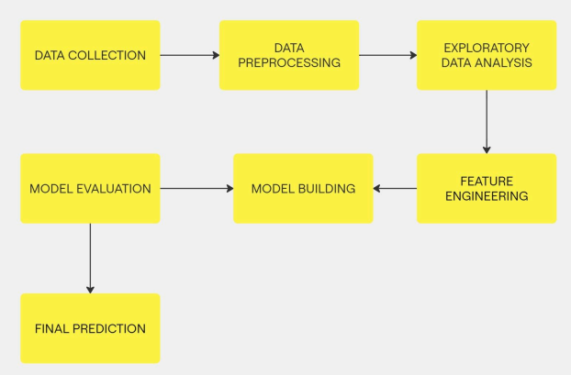
Methodology

Slide 5
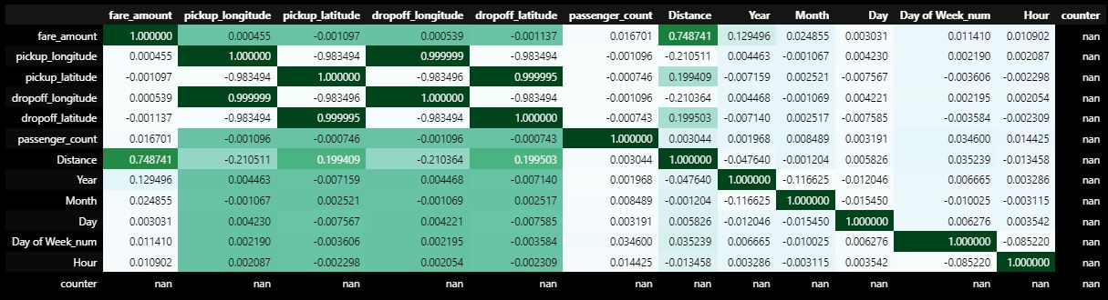
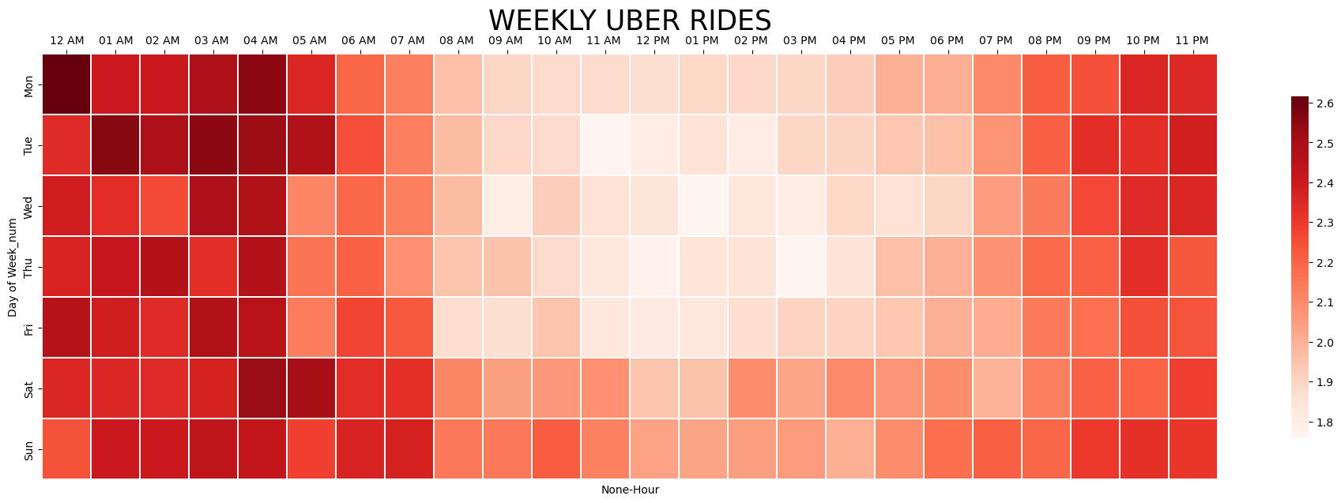
Correlation and Heat Map

Slide 6
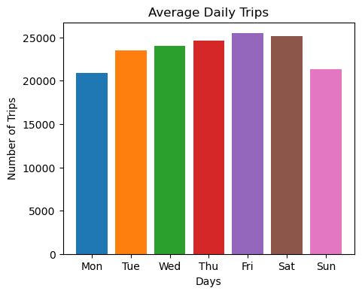
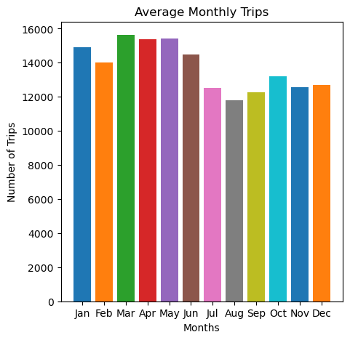
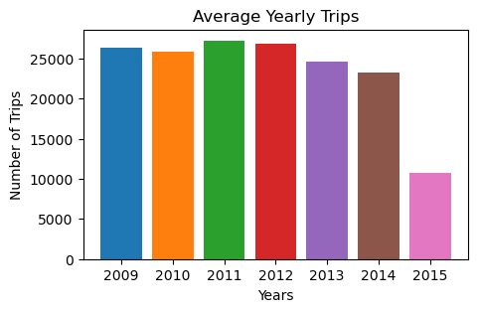
Average Trips Taken

Slide 7
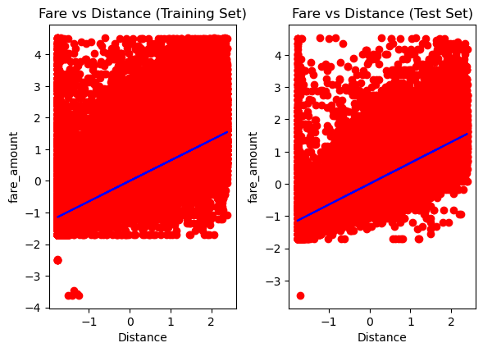
Linear Regression
MAE : 0.537
MSE : 0.582
RMSE : 0.763

Slide 8
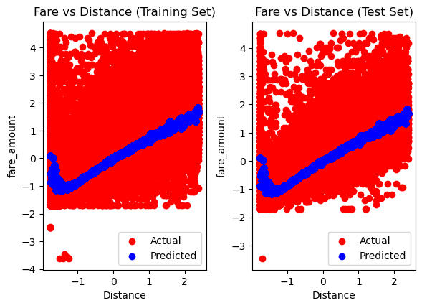
Random Forest
MAE : 0.507
MSE : 0.518
RMSE : 0.719

Slide 9
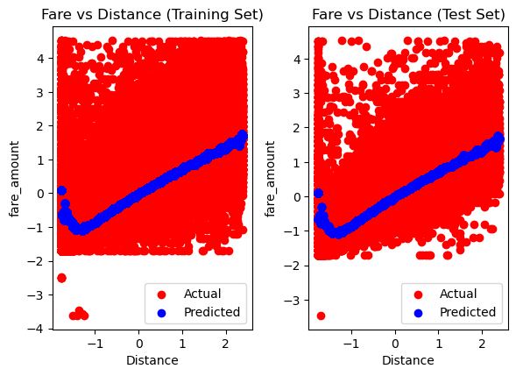
Gradient Boosting
MAE : 0.506
MSE : 0.515
RMSE : 0.718

Slide 10
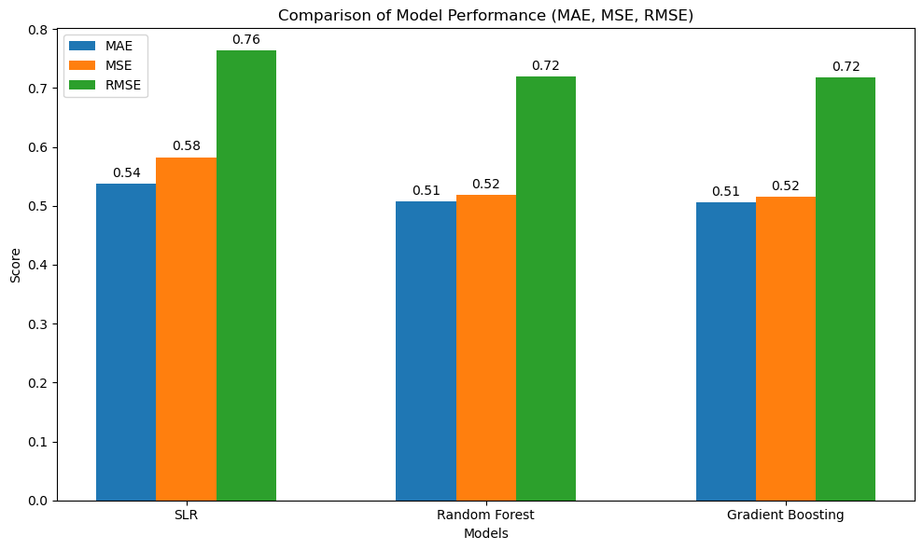
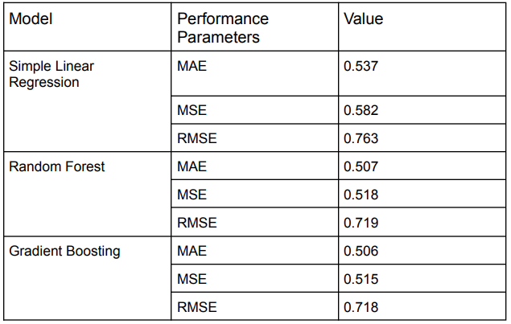
Final Comparison

Slide 11
Conclusion
The Uber Fare Prediction project effectively applies machine learning to predict ride fares with precision.
Gradient Boosting emerged as the best model, excelling in accuracy and minimizing error rates by effectively capturing complex, non-linear patterns in the data.
This project showcases the potential of machine learning to optimize ridesharing services and enhance dynamic pricing and user experience.
Future enhancements could incorporate real-time factors like traffic and weather for even greater accuracy and usability.

Slide 12
References
https://www.kaggle.com/datasets/yasserh/uber-fares-dataset
https://scikit-learn.org/stable/
https://www.geeksforgeeks.org/random-forest-regression-in-python/
Research Paper

